Slide 1
Assembly Language
Subject: CE-420 Computer Organization & Architecture
Session: Fall 2010
Course: BESE 15 A
Lab Instructor: Lab Engr. Nausheen

Slide 2
Course Outline for Labs
Data Representation (Decimal, Binary and Hexadecimal)
Basic Concepts: Registers, Flags
Introduction to Assembly Language (Purpose and Applications, Tools)
Using Debug
Assembly Language Instructions
  Data Transfer Instructions
  Arithmetic Instructions
  Transfer-of-Control Instruction
  Shift and Rotate Instructions
Address Calculation and Addressing Modes
Operators and Expressions
Conditional Processing
Procedures
DOS Function Calls
File Processing

Slide 3
Grading
Lab Assignments/Exercises and Project 50 Marks
Mid term 20 Marks
Final Lab Test 30 Marks

Slide 4
References
Chapter # 1-7,12, Appendix A & B, Assembly Language For The IBM-PC, 2nd Edition, Kip R. Irvine
Chapter # 3-4, Microprocessor And Interfacing (Program & Hardware), Douglas V. Hall
DEBUG Manual

Slide 5
Today’s Lab Outline
Registers
What is Assembly Language
Assembly Language Applications
Assembly Language Program Development
Using Debug

Slide 6
Lab # 2
Dated: Tuesday, September 28, 2010

Slide 7
Basic Concepts

Slide 8
Registers
Registers are high-speed storage locations inside the CPU, designed to be accessed at much higher speed than conventional memory.
Types of registers
  General Purpose/Data Registers
    Hold data for an operation to be performed
    There are 4 data registers (AX, BX, CX, DX)
  Segment Registers
    Hold the address of an instruction or data element
    Segment registers (CS, DS, ES, SS)
  Index and Pointer Registers
    Pointer registers (SP, BP, IP)
    Index registers (SI, DI)
  Status/Flags Register (FLAGS)
    Keeps the current status of CPU or results of arithmetic operations

Slide 9
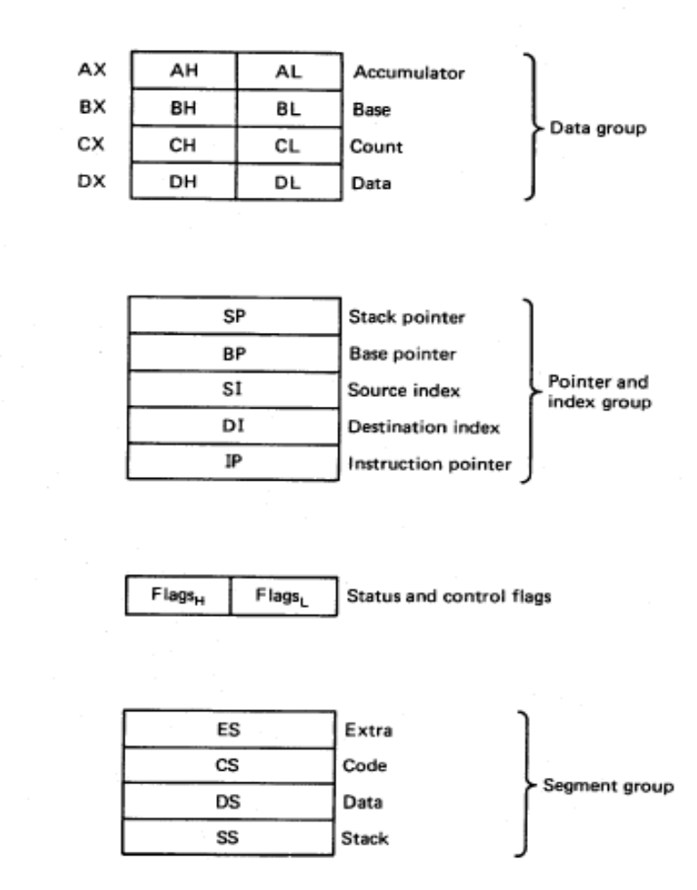
8086 Internal registers 16 bits (2 bytes each)
AX, BX, CX and DX are two
bytes wide and each byte can
be accessed separately
These registers are used as
memory pointers.
6 status; 3 control ; 7 unused
Segment registers are used
as base address for a segment

Slide 10
General Purpose Registers
AX (Accumulator): Used by CPU for arithmetic operations.
BX (Base): It can hold a memory address that points to a variable.
CX (Counter): Act as a counter for repeating or looping instructions. These instructions automatically repeat and decrement CX and quit when equals to 0.
DX (Data): It has a special role in multiply and divide operations.

Slide 11
Segment Registers
Generate memory addresses along with other registers
CS, DS, ES, SS
CS (Code): Defines the starting address of the section of memory holding code.
DS (Data): Defines the section of memory that holds most of the data used by programs.
ES (Extra): This is an additional data segment that is used by some of the string instructions.
SS (Stack): It defines the area of the memory used for stack

Slide 12
Pointers and Index Registers
IP, BP, SP, SI, DI
These can be accessed only as 16 bit registers.
IP - instruction pointer: Always points to next instruction to be executed. IP register always works together with CS segment register and it points to currently executing instruction.
SI - source index register: Can be used for pointer addressing of data. Offset address relative to DS
DI - destination index register: Can be used for pointer addressing of data . Offset address relative to ES
SI and DI used in string movement instructions.
SP and BP are used to access data inside the stack segment
BP - base pointer: Primarily used to access parameters passed via the stack. Offset address relative to SS
  SP – stack pointer: Always points to top item on the stack. Offset address relative to SS

Slide 13
80386 Extended Registers
The 80386/80486 processor contain 32-bit registers which greatly improve the efficiency of program that take advantage of them.
  EAX, EBX, ECX, EDX,
  EFLAGS
  EIP
  EBP, ESP, ESI, EDI.

Slide 14
Flag Register
16-bit special register
Each bit position is assigned to show the status of CPU or the results of arithmetic operations.
Each relevant bit position is given a name; other positions are undefined.
Two Types:
  Control Flags: Individual bits may be set to control the CPU’s Operation
  Status Flags: The Status bits reflect the outcome of arithmetic and logical operations performed by the CPU.

Slide 15
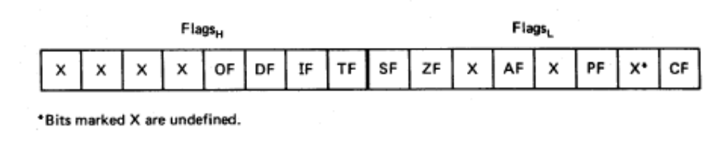
Flags
Carry flag
Overflow
Direction
Parity flag
Interrupt enable
Auxiliary flag
Trap
Zero
6 are status flags
3 are control flag
Sign

Slide 16
Status Flags
Carry Flag: The Carry Flag is set to 1 if after the result of an ALU operation, there is a carry out from the MSB else it is 0
Sign Flag: The Sign Flag is set to the value of the MSB. If the MSB is 0 then the Sign flag is 0, if the MSB is 1 then the Sign Flag is 1.
Zero Flag: If after an ALU operation the result of the operation is All Zeros, then the Zero Flag is set to 1 otherwise it is set to 0.
Overflow Flag: It is set when the signed result of an arithmetic operation is too large to fit into destination area.
Auxiliary Carry Flag: is set when an operation causes a carry from bit 3 to bit 4 or borrow from bit 4 to bit 3.
Parity Flag: reflects the number of bits in the result of an operation that are set. If number is even, parity is even. If it is odd, parity is odd. This is used by Operating System to verify correct transmission of data.

Slide 17
Control Flags
Direction Flag: Controls the assumed direction used by string processing instructions. 1=Up, 0=Down
Interrupt Flag: Enable/Disable external interrupt.
Trap Flag: determines whether or not CPU will be halted after each instruction.

Slide 18
Flag Examples
What is the state of the CF, OF, SF and ZF flags after the following additions.
00001011
10101011
10110111
10001011
10101000
00110011
There is no carry out of the MSB so CF=0
The MSB’s of the numbers are different so OF=0
The MSB of the Result is 1 so the SF=1
The Result is not all zeros so ZF=0
There is a carry out of the MSB so CF=1
The MSB’s of the numbers are same and result is different so OF=0
The MSB of the Result is 0 so the SF=0
The Result is not all zeros so ZF=0

Slide 19
Assembly Language: An Introduction

Slide 20
What is Assembly Language?
Two Levels of Programming Language:
  Low-Level
  High-Level
Low-Level Programming Languages are more close to hardware. Example: Machine Language, Assembly Language
High-level Programming Languages are simpler and more understandable. Example: C++, C#, Java etc

Slide 21
Contd..
Machine Language Programming
  Writing a list of numbers representing the bytes of machine instructions to be executed and data constants to be used by the program
  Example: 8B542408 83FA0077 06B80000 0000C383
Assembly Language Programming
  Using symbolic instructions to represent the raw data that will form the machine language program and initial data constants
  Example: mov ax, 0

Slide 22
Why Learn Assembly Language?
Learn how a processor works
Understand basic computer architecture
Explore the internal representation of data and instructions
Gain insight into hardware concepts
Allows creation of small and efficient programs
Allows programmers to bypass high-level language restrictions
Might be necessary to accomplish certain operations

Slide 23
Assembly Language Applications
Assembly Language Subroutine
  Programmers write subroutine in assembly language and call them from high-level language programs.
  Also known as Interface Subroutine / device drivers.
  Because they provide a convenient way to directly access the computers hardware.

Slide 24
Comparison
Type of application | High Level Language | Assemble Language
Business App software, written for single platform. | Formal structure make it easy to organize and maintain large section of code | No formal structure.
Hardware device driver | Language may not provide direct hardware access. Awkward coding techniques must be used. | Hardware access is simple and easy to maintain.
Business application written for multiple platforms. | Very portable. Source code can compile on each target OS with minimal changes, | Must be recorded separately for each platform, often using an assembler with different syntax. Not multiplatform programming.
Embedded systems and computer games requiring direct H/W access | Produce too much executable code, & may not run efficiently | Ideal because the executable code is small and runs quickly.

Slide 25
AL Program Development
Editor:
  Allows you to create a file containing assembly language statements for your program.
  Examples: PC Write, Word Star and editors that comes with assembler.
  The source file must be saved with extension .ASM
Assembler:
  Translates assembly language instructions to binary codes.
  It reads a code in two passes.
  In Pass1, it determines the displacement of named data items, the offsets of label, etc. and puts this information in a symbol table.
  In Pass 2, it produces binary code for each instruction and insert the offset, etc. that is calculated during Pass 1.
  Output: .OBJ and .LST files.
  .OBJ contains binary codes for the instructions and information about the addresses of instructions.
  .LST contains your AL statements, binary code and offset for each instruction . It also indicates syntax errors.
  Note: Assembler generates offset not absolute address.

Slide 26
Contd..
Linker:
  Joins several object files into one large EXE file.
  Produces a Link file which contains the binary codes for all combined modules.
  Produces a Link Map file which contains address information about the linked files.
Locator:
  Converts .EXE to .BIN files which contain physical addresses.
  E.g. EXE2BIN comes with IBM DOS.
Debugger:
  Loads and run .EXE file (loads program into memory and assign physical addresses)
  Allows you to troubleshoot program
  Allows you to view and modify contents of register and memory locations.
  E.g. Basic Debugger with DOS, Borland’s TURBO Debugger, Microsoft CodeView Debugger.

Slide 27
Contd..
Emulator:
  Used to test hardware and software of an external system such as prototype of a microprocessor based instrument.
  Allows you to load and run program, examine and change contents of register.
  Also takes snapshot of contents of register, activity on the address and data busses, the state of flags as each instruction executes.
  Two parts: Hardware (to connect with host system), Software (to download your object code program into RAM of host system and run it)
  Example: EMU8086

Slide 28
Program Development Algorithm
.ASM
Start
Define Problem
Develop Algorithm
Create Source File with Editor
Yes
Assembly Errors ?
.EXE & .MAP
.BIN
External System?
Assemble
Link
Locate
.OBJ & .LST
No
No
Load Debugger
Load Program
Run & Test Program
Errors ?
No
Stop
Yes
Use Debugger Tools to find Errors

Slide 29
Using DEBUG

Slide 30
How to Invoke Debug
To invoke the DEBUG program, open DOS window and enter the following command:
C:\> debug <enter>
OR Click on the start button, choose run, and enter debug.
DEBUG command responds with the hyphen - prompt.
The hyphen prompt indicates that DEBUG is ready to accept commands in an interactive environment.
One of the most important commands is ? which gives a summary of all valid commands.
Invoke DEBUG now and list all commands:
C:\> debug <enter>
-? <enter>
You should get a list of all commands displayed to the screen. They may all be invoked with single letters, some requiring additional arguments.

Slide 31
Debug Command Summary
Program Creation and Debugging
  A: Assemble a program using instruction mnemonics
  G : Execute the program currently in memory
  R: Display the contents of register and flags
  P: Trace past an instruction, procedure, or loop
  T: Trace a single instruction
  U: Disassemble memory into assembler mnemonics
Memory Manipulation
  C: Compare one memory range with another
  D: Dump (display) the contents of memory
  E: Enter bytes into memory.
  F: Fill a memory range with a single value
  M: Move bytes from one memory range to another
  S: Search a memory range for specific value

Slide 32
Contd..
Miscellaneous
  H: Perform hexadecimal addition and subtraction
  Q: Quit DEBUG and return to DOS
Input-Output
  I: Input a byte from port
  L: Load data from disk
  O: Output a byte to a port
  N: Create a filename for use by the L and W Commands
  W: Write data from memory to disk.
NOTE:
  All these instructions are case insensitive i.e. you can write either –R or -r. Both commands will work.

Slide 33
R [Register]
The x86 (at least the 8086 version) contains 14 basic registers. To examine the content of the registers, enter the following:
-r <enter>
Notice the 2-letter abbreviations on the far right side of the second line. These indicate the values of the bits in the FLAGS register.
The R command may be used in one of three ways:
  Display the contents of one register, allowing it to be changed.
  Display registers, flags, and the next instruction about to be executed.
  Display the eight flag settings, allowing any or all of them to be changed.

Slide 34
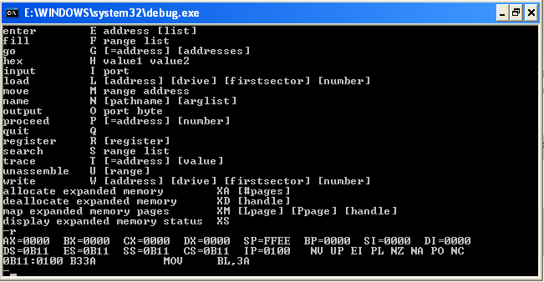

Slide 35
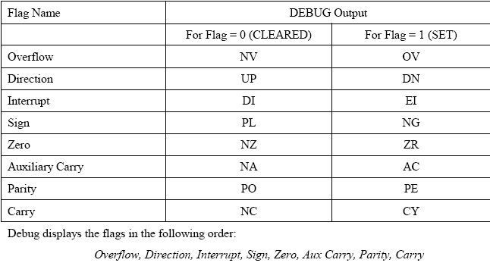

Slide 36
Contd..
Example | Comment
R | Display the contents of all registers
R IP | Display the contents of IP, and allow it to be modified.
R CX | Same (for CX register)
R F | Display all flags, and change them if desired.

Slide 37
Contd..
To examine and change the content of a single register, the r command can be used with a register name as the argument.
As an example, enter the following:
-r ax <enter>
ax 0000
:3A7 <enter>
Now examine the registers again using the r command. You should see that register ax now contains 03A7.
Exercise: Load the value, 92A into the bx register using the r command. Verify that bx and ax contain the values 3A7 and 92A respectively.

Slide 38
H [Hexarithmetic]
H is the DEBUG command that returns both the sum and difference of two hexadecimal numbers.
Syntax: -H value1 value2 <enter>
From a DEBUG prompt, enter the following:
-H 3 2 <enter>
You should see the following appear on your screen:
0005 0001
This is the sum and difference respectively, 3+2=5 and 3-2=1. Now try:
-H 2 3 <enter>
In this case, the negative difference, 2-3, is represented in 2’s complement form. A negative number can always be identified by checking if the leading bit (MSB) is set to 1. However, a positive sum can also have MSB=1. It is UP TO THE PROGRAMMER to interpret the result correctly.

Slide 39
Q [Quit]
Q is the DEBUG command to quit from debug mode.

Slide 40
Next Lab Topic
Basic Elements of Assembly Language
Assembly Language Instructions
  Data Transfer Instructions
  Arithmetic Instructions
Sample Programs

